Slide 1
RGUKT HOSPITAL MANAGEMNET SYSTEM

Slide 2
Ms. P Archana P.h.D,
Assistant Professor,
Department of computer science engineering,
RGUKT ongole ,A.P .
T. Srikanth (O180454)
A. Kavya (O180491)
P. Sowjanya (O180485)
K. Sireesha (O180483)
-Team-13

Slide 3
Contents
Abstract
Introduction
Technologies Used
Problem Statement
Results(till now)
Screenshots
Advantages
Future Scope
Conclusion

Slide 4
ABSTRACT
Medicines are one of the important factors that are necessary to cure a person’s diseases, due to delay of the medicines, there are chances that the person might even loose his/her life. To solve these all problems Hospital management system plays crucial role. The project is designed for developing the hospital management system whose purpose is to reduce the complexities of record keeping and documentation in the inventory management, on the basis of database management system we can manage the stock of the medicines, students records, staff details of the hospital very easily and also we can update the medical details time to time without overdue. The system provides information of all the medicines at a single portal which is accessed by all the student of RGUKT ongole ,A.P. the admin can manage the staff information and medicine information. We can check the availability of staff and medicines.

Slide 5
INTRODUCTION
Our project is about maintaining the medical records of RGUKT Ongole hospital .On the basis of database management system using sql. Here we can manage the stock of the medicines, staff details of the hospital. The purpose of Medical Store Management System is to automate the existing manual system by the help of computerized equipment’s and full -fledged computer software, fulfilling their requirements ,so that their valuable data/information can be stored for a longer period with easy accessing and manipulation of the same. The required software and hardware are easily available and easy to work with. Medical Store Management System, as described above, can lead to error free secure, reliable and fast management system. It can assist the user to concentrate on the record keeping, Thus it will help organization in better utilization of resources.

Slide 6
PROBLEM STATEMENT
In hospitals it would be difficult to maintain all the students, doctors and medicine records in register books . Even if we maintain all these things it may won’t show us the hospital medicines and other records in an efficient and effective manner.
If we maintain records in books, students can’t find the medicine details and can’t do availability check .
To resolve all these problems we have developed this hospital management system.

Slide 7
TECHNOLOGIES USED
Software Requirements:
Operating System: Windows 10
Developing Platform: IDLE,
Visual Studio Code,
Xampp server.
Hardware Requirements:
Processor: Intel Core I3/ I5/ I7
RAM: 8GB
Storage: 20GB
Floppy drive
Monitor with 1024*720 resolution
Hard drive
keyboard

Slide 8
LANGUAGES USED
Frontend Languages :
HTML
CSS
JavaScript & Bootstrap
Jquery
Backend Languages :
PHP
Mysql server

Slide 9
Results
During this time, we have worked on student record collection, medicines collection, availability check of doctors and medicines and to search for the medicine we want and finally This project help the hospital management and student as well as in an efficient manner.

Slide 10
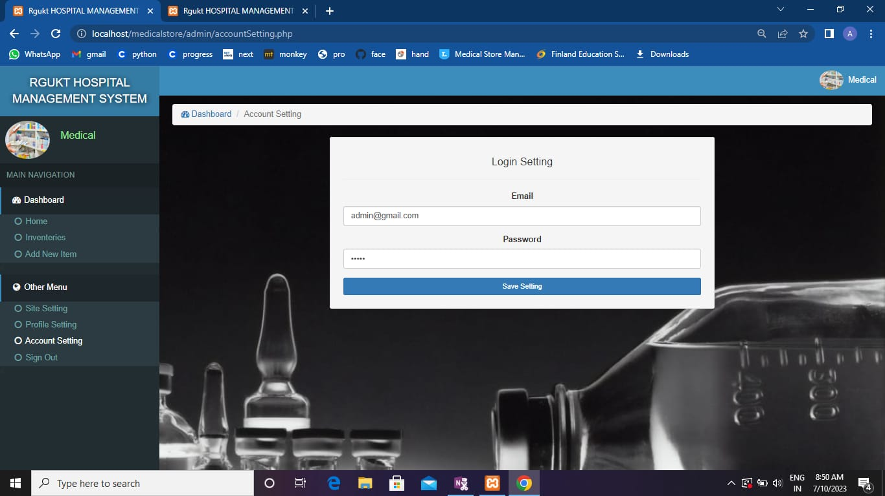
Admin Account Settings

Slide 11
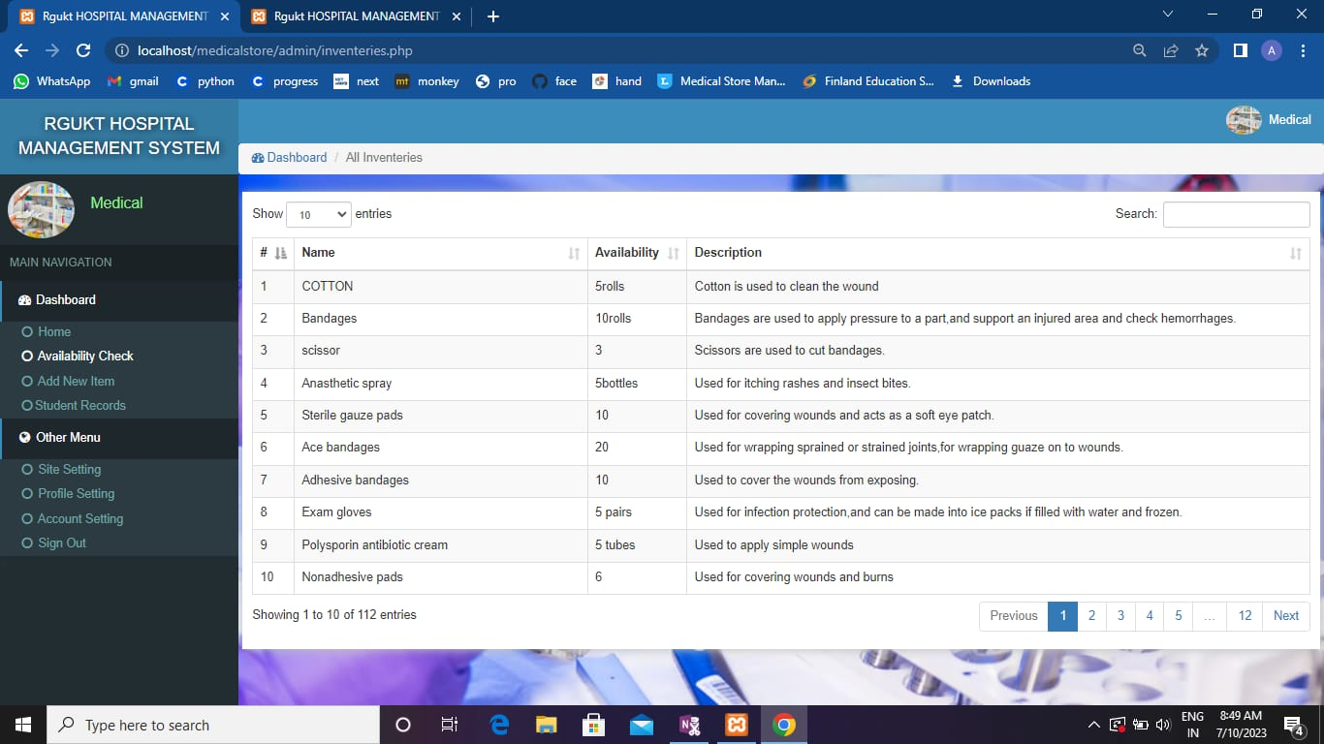
Admin availability check

Slide 12
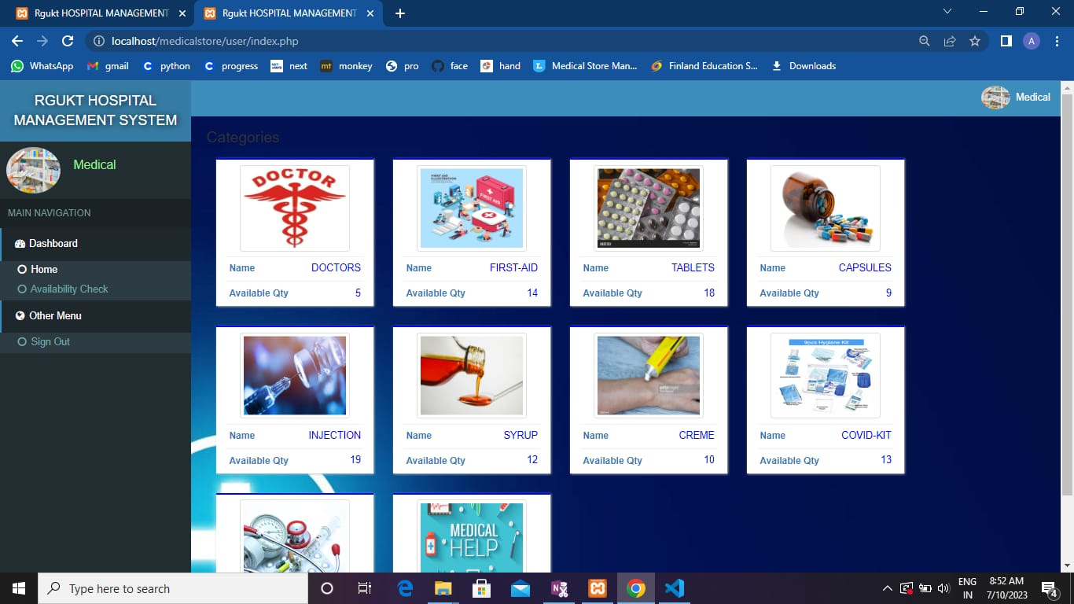
User home page

Slide 13
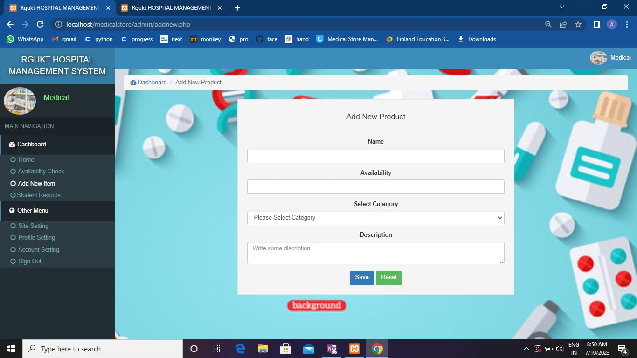
Adding new items

Slide 14
Advantages
The addition of advanced technology in our system has led to the increased management of large volume of data in the case of RGUKT Ongole .
The main purpose of our project is to edit, save as well as correctly manipulate student records and medicine details.
Students will able to check doctor’s availability timings and availability of medicines.
It has been productive to manage the things automatically when compared to the old day manual setup.
We can store the details of RGUKT Ongole hospital for a long period of time.

Slide 15
Future Scope
we would use firewalls and advanced security features, so we can decrease the security vulnerabilities, threats and attacks .
We would convert this web oriented system into application oriented system.
We can add student helpline feature .

Slide 16
CONCLUSION
The purpose of “RGUKT HOSPITAL MANAGEMENT SYSTEM” is to automate the existing manual system by the help of computerized equipment and full fledged computer software, fulfilling their requirements , so that their valuable data/information can be stored for a longer period with easy accessing and manipulation of the same. This system provides an easy way for the operator to interact with the database and to manipulate the data in the database. The operator can add, delete and update the records in the database with ease. In this the major components are inventory and warehouse management. It is also manage the details of stock, staff and company.

Slide 17

THANK YOU

